Slide 1
Optimized Implementation of Encapsulation
and Decapsulation of Classic McEliece on ARMv8
National Cryptography Contest 2022
2022/09/15

Slide 2
CONTENTS
01
02
03
Introduction
Our Works
Conclusion
Encapsulation Optimization
Decapsulation Optimization
Evaluation
2

Slide 3
01
Introduction
3

Slide 4
01.
Target Cipher
For the smooth dissemination of Post Quantum Cryptography(PQC), the optimal implementation of PQC was selected as our topic.
We select Classic McEliece as target cipher.
Only code-based cipher from the NIST PQC Round 4.
The parameters of Classic McEliece are shown in [Table 1].
Algorithm | m | n | t | level | Public key | Secret key | Ciphertext
Mceliece 348864 | 12 | 3488 | 64 | 1 | 261,120 | 6,492 | 128
Mceliece 460896 | 13 | 4608 | 86 | 3 | 524,160 | 13,608 | 188
Mceliece 6688128 | 13 | 6688 | 128 | 5 | 1,044,992 | 13,932 | 240
Mceliece 6960119 | 13 | 6960 | 119 | 5 | 1,047,319 | 13,948 | 226
Mceliece 8192128 | 13 | 8192 | 128 | 5 | 1,357,824 | 14,120 | 240
Table 1. Parameters of Classic McEliece.
4

Slide 5

01.
Target Processor
We select 64-bit ARMv8 Processor.
Widely used high-performance processors.
Using the latest Apple M1 chip with ARMv8 architecture.
Utilize both general register and vector register.
Parallel implementation using vector instructions.
5

Slide 6
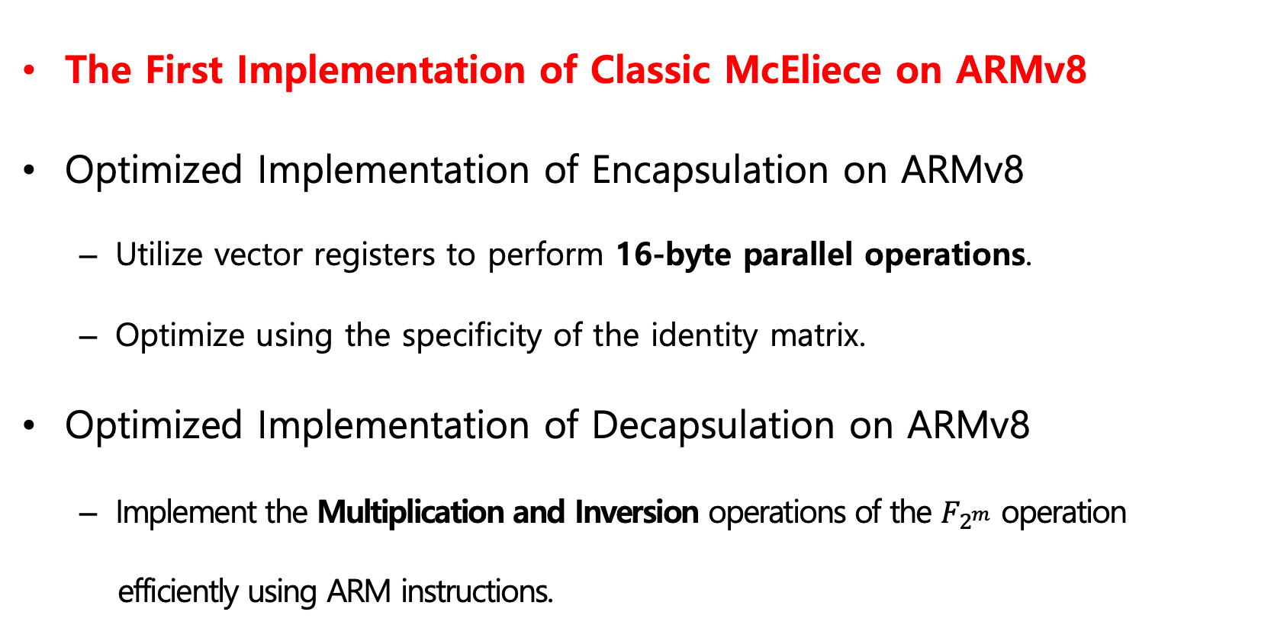
01.
Contribution
The First Implementation of Classic McEliece on ARMv8
Optimized Implementation of Encapsulation on ARMv8
Utilize vector registers to perform 16-byte parallel operations.
Optimize using the specificity of the identity matrix.
Optimized Implementation of Decapsulation on ARMv8
Implement the Multiplication and Inversion operations of the $F_{2^{m}}$ operation
efficiently using ARM instructions.
6

Slide 7
02
Our work
7

Slide 8
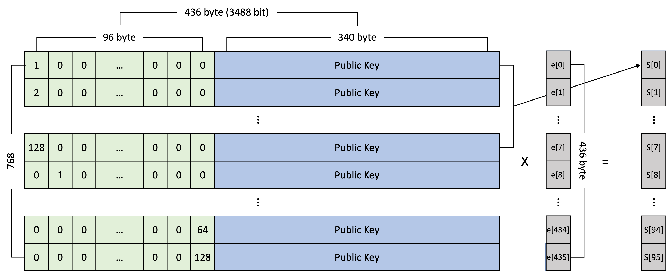
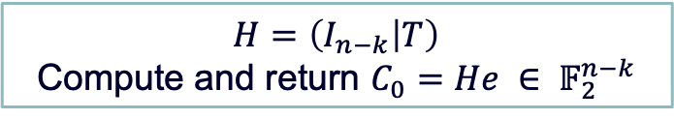
02.
Encapsulation
Define of ENCODE
$$H=\left(I_{n−k} | T\right)$$
Compute and return $C_{0}=He ∈ 𝔽_{2}^{n−k}$
Excluding the hash process from encapsulation
It can be divided into two processes : random vector generation and syndrome generation.
Optimize the syndrome generation (ENCODE process)
Figure 1. ENCODE process of Encapsulation(In Classic McEliece-348864)
8

Slide 9
02.
Encapsulation
96-byte corresponding to the identity matrix are 0 except for 1-byte.
The operation of the identity matrix part may be omitted except for 1-byte.
Figure 1. ENCODE process of Encapsulation(In Classic McEliece-348864)
9

Slide 10
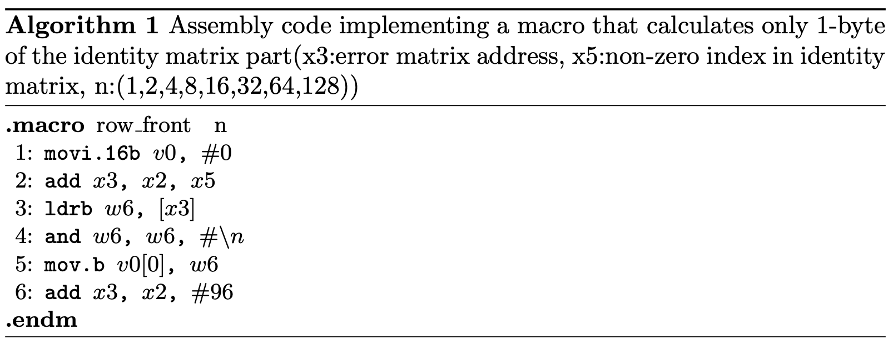
02.
Encapsulation
For non-zero values, 8 values (1,2,4,8,16,32,64,128) are used repeatedly.
The operation is performed by calling only the error value that has an index equal to a nonzero matrix index.
Algorithm 1 show the implementation of the identity matrix part.
Figure 1. ENCODE process of Encapsulation(In Classic McEliece-348864)
10

Slide 11
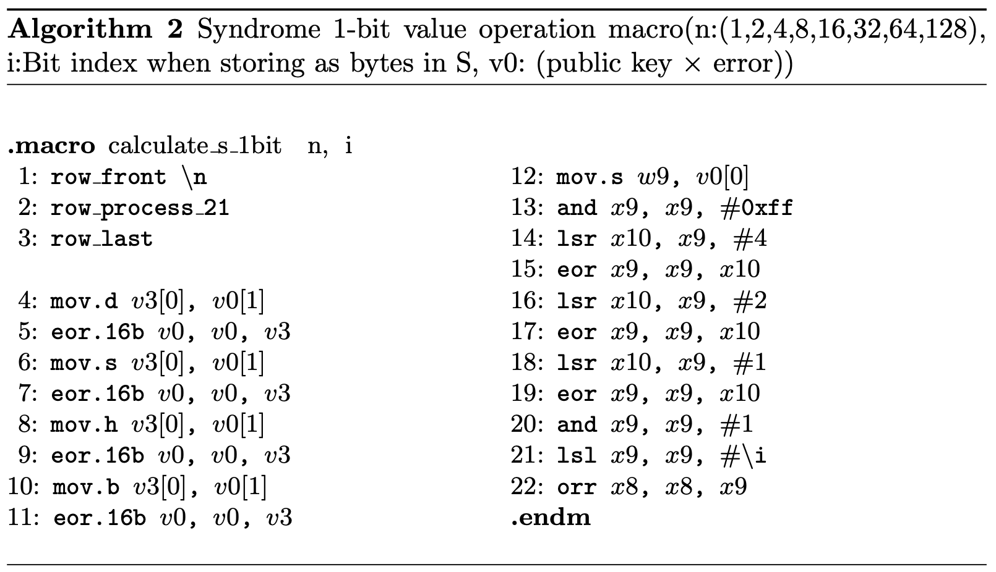
02.
Encapsulation
16-byte parallel operation was performed using vector registers.
Algorithm 2 is the assembly code to calculate the 1-bit syndrome.
In parallel, the public key and the error
are computed.
Obtain 1-bit value from the calculated value.
Collect the divided values into 1-byte.
Figure 1. ENCODE process of Encapsulation(In Classic McEliece-348864)
11

Slide 12
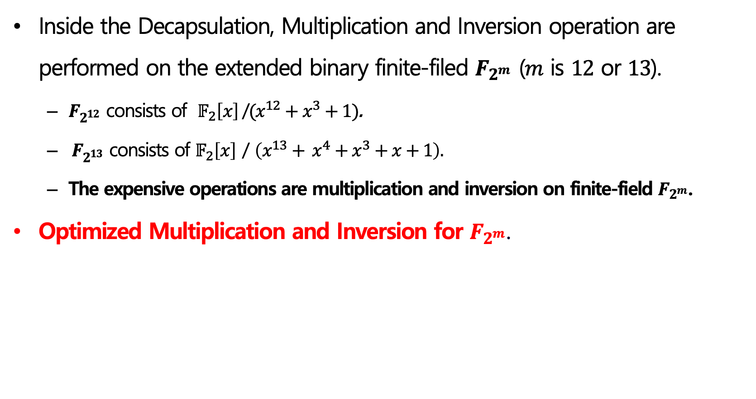
02.
Decapsulation
Inside the Decapsulation, Multiplication and Inversion operation are performed on the extended binary finite-filed $F_{2^{m}}$ ($m$ is $12$ or $13$).
$F_{2^{12}}$ consists of $𝔽_{2}\left[x\right]$/$(x^{12}+x^{3}+1)$.
$F_{2^{13}}$ consists of $𝔽_{2}\left[x\right]$ / $\left(x^{13}+ x^{4}+x^{3}+x+1\right).$
The expensive operations are multiplication and inversion on finite-field $F_{2^{m}}$.
Optimized Multiplication and Inversion for $F_{2^{m}}$.
12

Slide 13
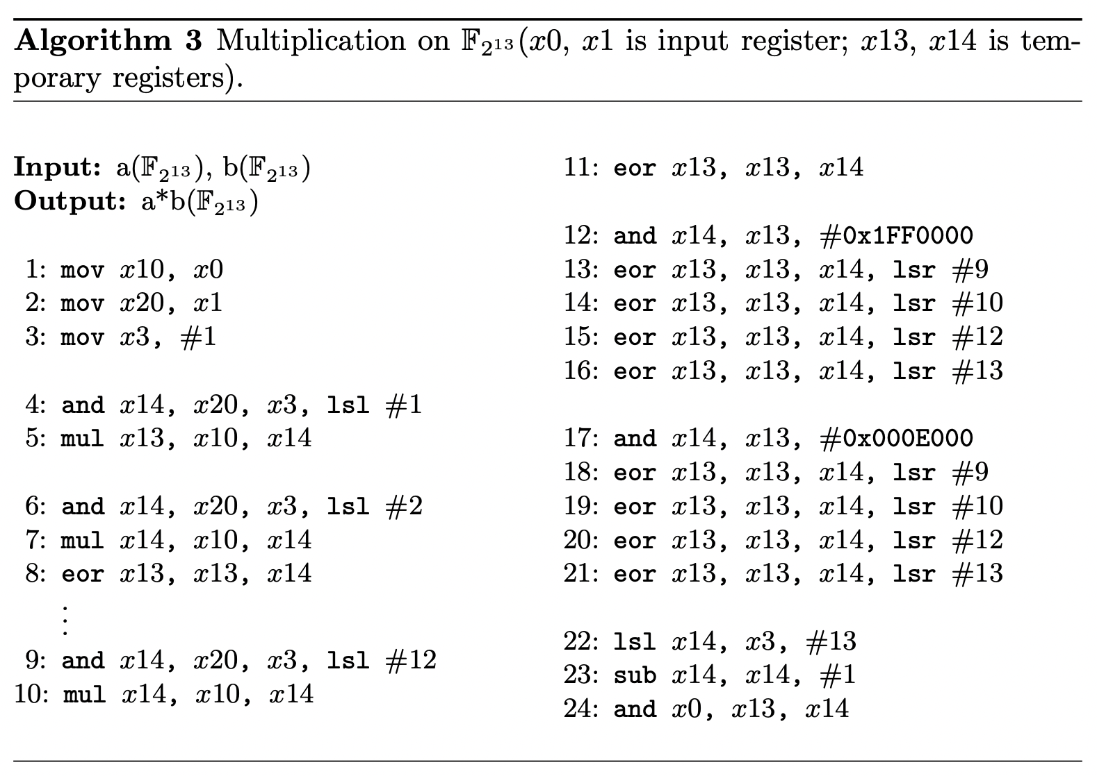
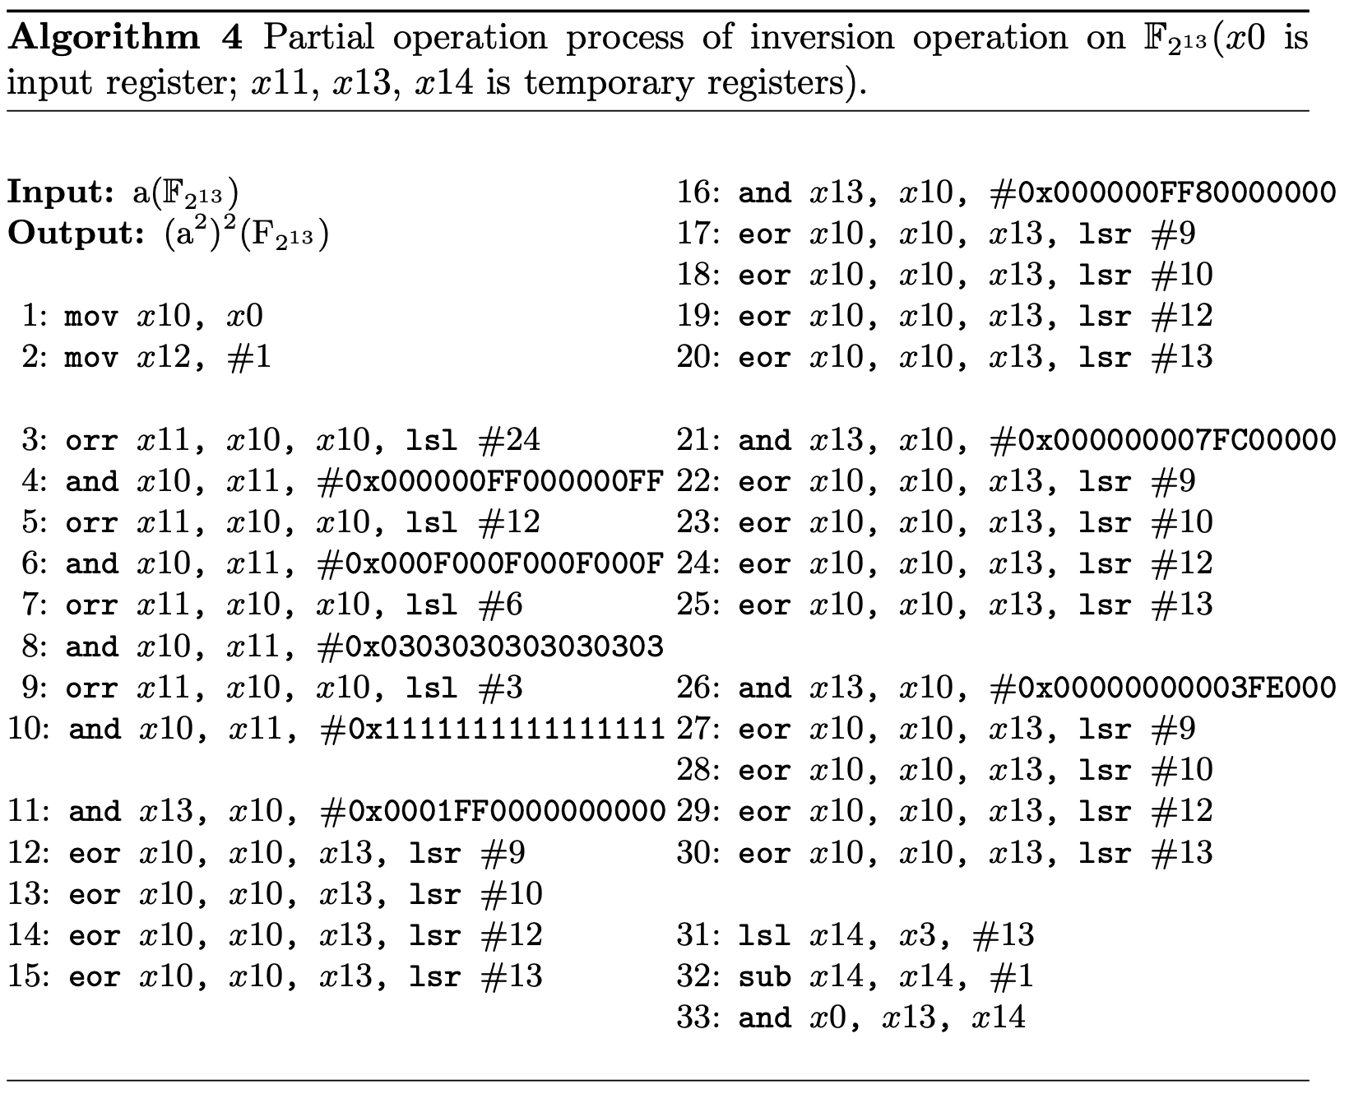
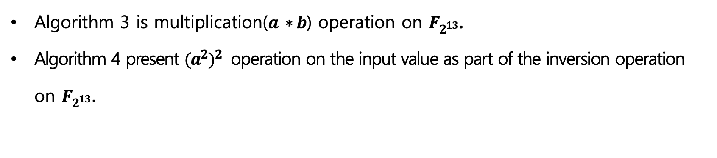
02.
Decapsulation
Algorithm 3 is multiplication($a ∗b$) operation on $F_{2^{13}}$.
Algorithm 4 present ${(a^{2})}^{2}$ operation on the input value as part of the inversion operation on $F_{2^{13}}$.
13

Slide 14
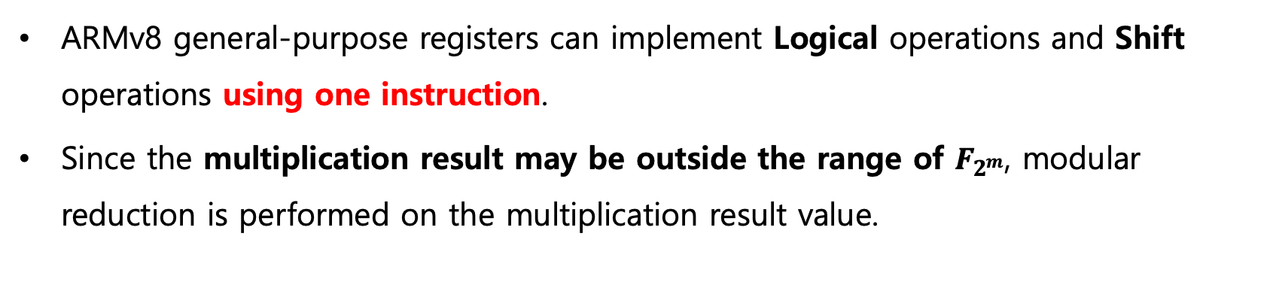
02.
Decapsulation
ARMv8 general-purpose registers can implement Logical operations and Shift operations using one instruction.
Since the multiplication result may be outside the range of $F_{2^{m}}$, modular reduction is performed on the multiplication result value.
14

Slide 15
02.
Evaluation
Implementation Environment
Machine: Apple Macbook Pro 13 with Apple M1 chip (3.2GHz)
Framework: Xcode Integrated Development Environment
Assessment Methods
Since ARMv8 does not have a Classic McEliece implementation,
the performance is compared with the PQ-Clean project reference code[1].
Encapsulation(up to ENCODE) and Decapsulation(up to DECODE) was repeated by 1,000 times to measure the operation time.
15

Slide 16
02.
Evaluation
It shows a performance improvement over the existing Classic McEliece[1].
Mceliece 348864 : Encapsulation 14.11 times, Decapsulation 2.24 times
Mceliece 460896 : Encapsulation 15.33 times, Decapsulation 1.93 times
Mceliece 6688128 : Encapsulation 14.75 times, Decapsulation 1.92 times
Mceliece 6960119 : Encapsulation 7.64, times Decapsulation 2.04 times
Mceliece 8192128 : Encapsulation 14.38 times, Decapsulation 1.96 times
Algorithm | Encapsulation(up to ENCODE) |  | Decapsulation(up to DECODE)
 | [1] | Our work | [1] | Our work
Mceliece 348864 | 555,789.625 | 39,512.469 | 16,148,425.313 | 7,204,017.813
Mceliece 460896 | 1,236,170.406 | 80,643.812 | 32,543,014.063 | 16,820,844.063
Mceliece 6688128 | 2,299,348.187 | 155,855.156 | 62,416,464.375 | 32,428,698.438
Mceliece 6960119 | 2,636,024.437 | 345,173.812 | 63,814,351.563 | 31,352,953.750
Mceliece 8192128 | 2,808,967.125 | 195,299.187 | 77,021,110.625 | 39,569,996.875
Table 2. Evaluation result on ARMv8 in terms of execution timing (i.e. clock cycles)
16

Slide 17
02.
Evaluation
Encapsulation : Performance improvement from 7.64 to 15.33 times
Decapsulation : Performance improvement from 1.92 to 2.24 times
Algorithm | Encapsulation(up to ENCODE) |  | Decapsulation(up to DECODE)
 | [1] | Our work | [1] | Our work
Mceliece 348864 | 555,789.625 | 39,512.469 | 16,148,425.313 | 7,204,017.813
Mceliece 460896 | 1,236,170.406 | 80,643.812 | 32,543,014.063 | 16,820,844.063
Mceliece 6688128 | 2,299,348.187 | 155,855.156 | 62,416,464.375 | 32,428,698.438
Mceliece 6960119 | 2,636,024.437 | 345,173.812 | 63,814,351.563 | 31,352,953.750
Mceliece 8192128 | 2,808,967.125 | 195,299.187 | 77,021,110.625 | 39,569,996.875
Table 2. Evaluation result on ARMv8 in terms of execution timing (i.e. clock cycles)
17

Slide 18
03
Conclusion
18

Slide 19
03.
Conclusion
The First Implementation of Classic McEliece on ARMv8.
Implemented the optimization of Classic McEliece Encapsulation and Decapsulation on ARMv8.
In Encapsulation
Sufficient performance improvement was achieved only through optimization of syndrome generation.
Performance improvement of 7.64~15.33 times.
In Decapsulation
Optimization of multiplication and inversion operation.
Performance improvement of 1.92∼2.24 times.
19

Slide 20
Thank you
National Cryptography Contest 2022
20

Slide 21
Appendix
[1] “PQClean project.” Available online: https://github.com/PQClean/PQClean. Accessed: 2022-07-29.
21

